Slide 1
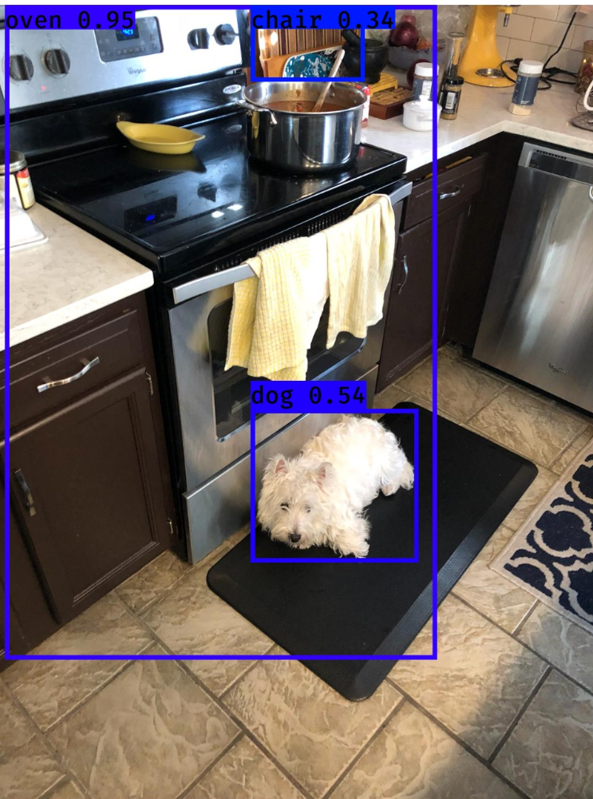
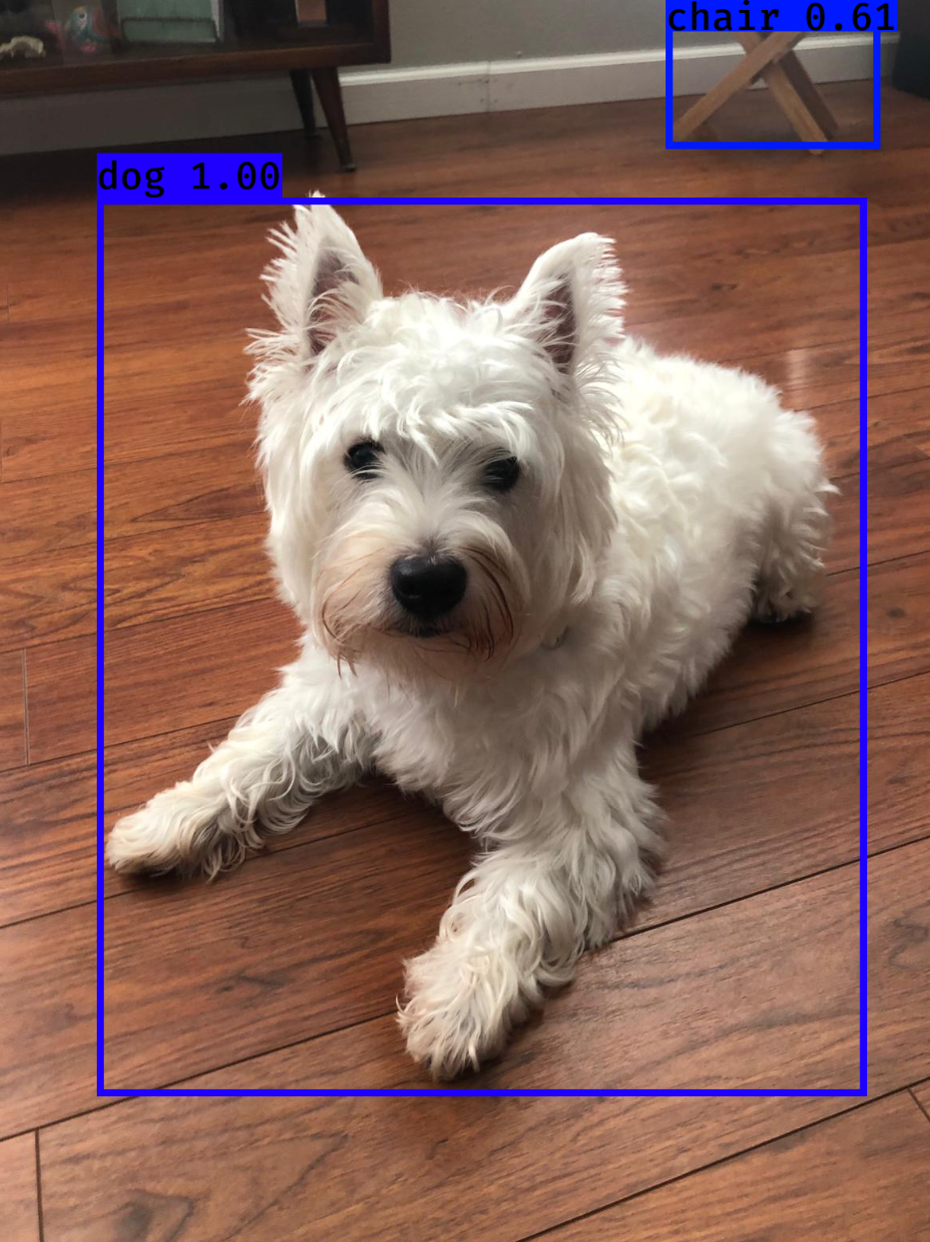
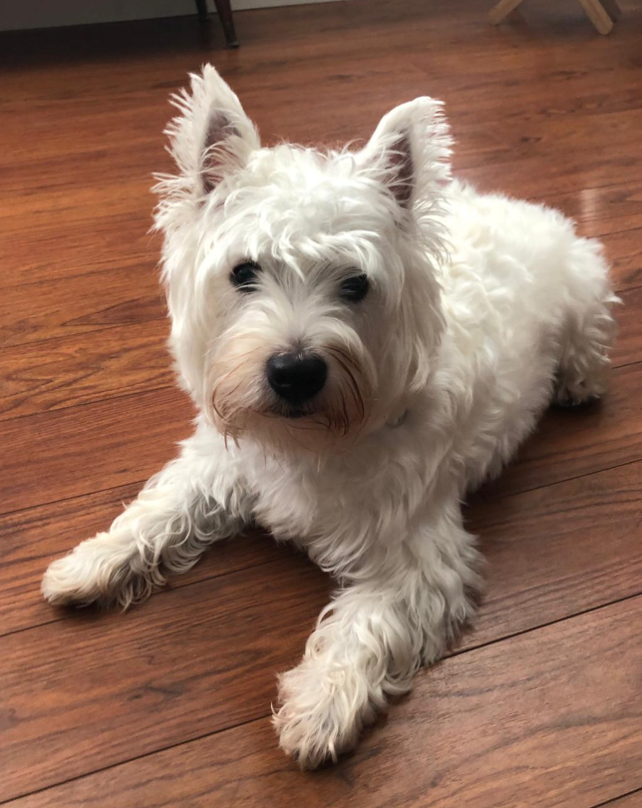
Run pretrained YOLO v3 on local machine
Used a Keras implementation of YOLO v3 with TensorFlow backend (Source: https://github.com/qqwweee/keras-yolo3)
Uses DarkNet model CFG and weights (pjreddie darknet/yolo). Darknet pretrained 1000 class ImageNet (maybe others).
Ran model to detect “Momo” (“Westie” breed) – image & video
Found 3 boxes for img
oven 0.95 (14, 0) (882, 1314)
chair 0.34 (508, 0) (737, 153)
dog 0.54 (508, 811) (845, 1119)
Found 2 boxes for img
chair 0.61 (851, 0) (1120, 195)
dog 1.00 (136, 257) (1103, 1386)

Slide 2
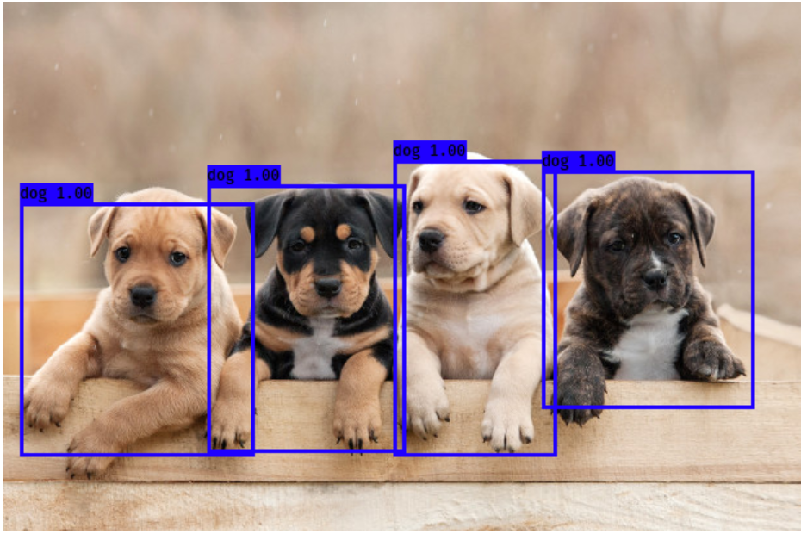
Run pretrained YOLO v3 on local machine (multiples of same object type)
Found 4 boxes for img
dog 1.00 (158, 141) (311, 348)
dog 1.00 (13, 155) (194, 351)
dog 1.00 (302, 122) (428, 351)
dog 1.00 (417, 130) (581, 314)
https://nypost.com/2018/10/23/a-dogs-color-could-impact-how-long-they-live/ - Image source

Slide 3
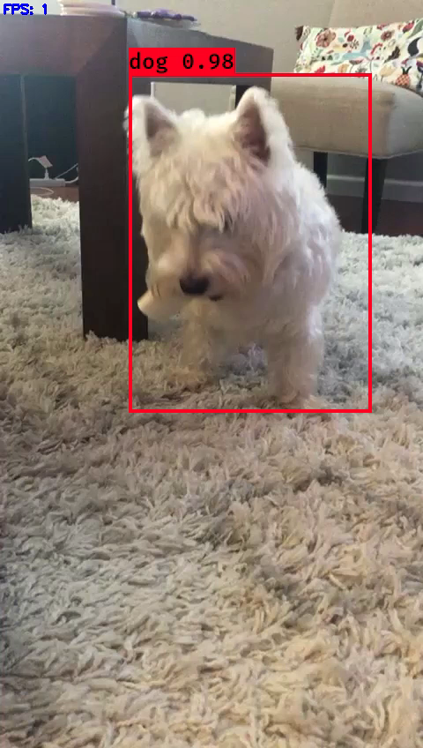
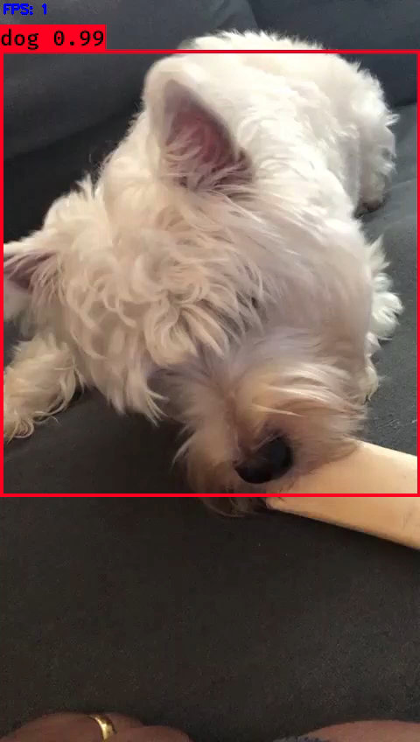
Video samples

Slide 4
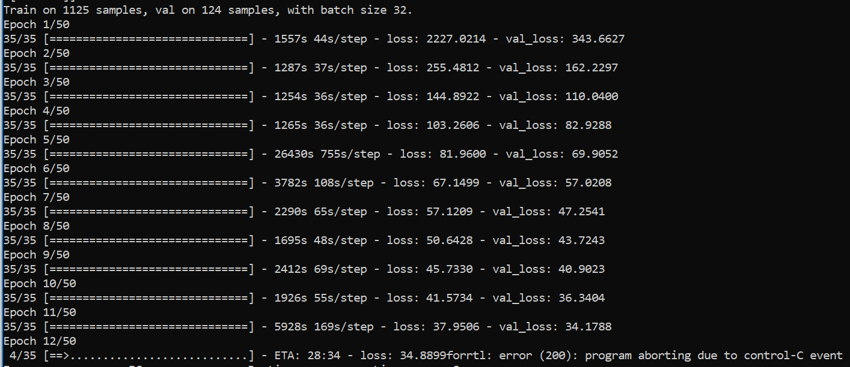
Attempted training on local machine (No GPU)
Extending DarkNet Yolo v3 to train 3 Simpson characters: 913+623+1342 images
Started training 1342 set = 13 hours (terminated)
All default settings used to train COCO and Pascal VOC retained as is.
Yolo can work with any image size – it retains aspect ratio while resizing

